Slide 1

PySpark ML: Iris Classification with Logistic Regression
A Hands-on Machine Learning Experiment

Slide 2

The Classic Iris Dataset
A Foundation for Classification
Dataset Overview
Key Features
▪
150 samples
of Iris flowers
Sepal Length – Outer structure length
▪
Benchmark for
classification
▪
Clean, well-structured data
Sepal Width – Outer structure width
▪
Ideal for demonstrating ML concepts
▪
Widely used in research
Petal Length – Inner petal length
Target Classes
Petal Width – Inner petal width
▪
Iris Setosa
▪
Iris Versicolor
▪
Iris Virginica
The Iris dataset provides a simple yet powerful problem for demonstrating classification algorithms without complex data preprocessing.

Slide 3

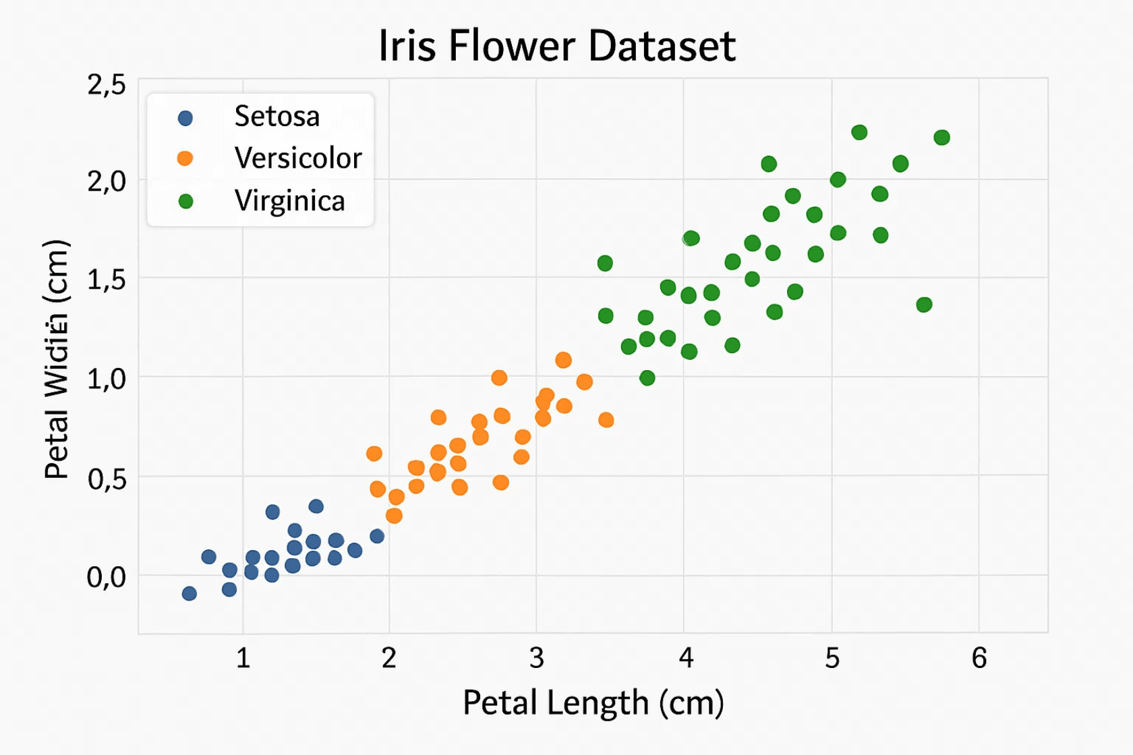
Visualizing Feature Distributions
Reveals Class Separability
Key Observations
▪
Petal Length & Width
show clear separation between species
▪
Setosa
is completely distinct from other species
▪
Versicolor and Virginica show some overlap
▪
Feature distributions are
highly predictive
Most Important Features
▪
Petal Length
– Best discriminator
▪
Petal Width
– Strong separator
▪
Sepal measurements less discriminative
Implication: A linear classifier like Logistic Regression has excellent potential to succeed on this problem due to the clear class separability in the feature space.

Slide 4

Initializing the PySpark ML Workflow
SparkSession
Create SparkSession
The SparkSession is the entry point for all Spark functionality. It provides access to distributed computing capabilities.
spark = SparkSession.builder \ .appName("IrisClassification") \ .config("spark.sql.adaptive.enabled", "true") \ .getOrCreate()
Gateway to Spark operations
▪
Manages cluster resources
Convert to Spark DataFrame
▪
Enables distributed processing
iris_spark_df = spark.createDataFrame( iris_pd.drop('species', axis=1) )
▪
Data Conversion
Key Configuration
Convert Pandas DataFrame to Spark DataFrame for distributed ML operations.
• appName: Identifies the application • config: Sets Spark parameters • getOrCreate(): Gets or creates session
Required for PySpark ML models
▪
Enables parallel processing
▪
Scalable to large datasets
▪

Slide 5
Preparing Data for PySpark ML with RFormula
Train-Test Split Strategy
The dataset is divided into training and testing sets to evaluate model performance on unseen data.
80%
20%
Training Data
Testing Data
121 samples
29 samples
train_data, test_data = iris_spark_df.randomSplit([0.8, 0.2], seed=42)
Feature Vectorization with RFormula
PySpark ML models require features to be combined into a single vector column. RFormula handles this automatically:
r_formula = RFormula(formula="label ~ .", featuresCol="features", labelCol="label")
✓
Formula syntax:label ~ . means predict "label" using all available features (the dot represents all columns except the target)

Slide 6

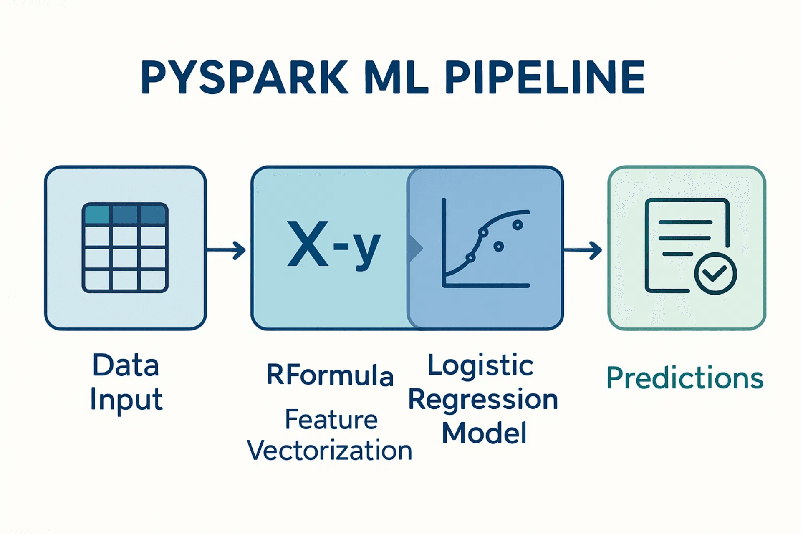
Building the Classification Pipeline
with Logistic Regression
Model Selection
▪
Logistic Regression
for multi-class classification
▪
Simple yet effective algorithm
▪
Efficient for this problem
Hyperparameters
▪
maxIter=100
– Maximum iterations
▪
regParam=0.01
– Regularization parameter
▪
Prevents overfitting
▪
Maintains model simplicity
Pipeline Benefits
▪
Chains steps sequentially
▪
Ensures reproducibility
▪
Simplifies deployment
▪
Easy to reuse and modify
Pipeline Construction Code
r_formula = RFormula(formula="label ~ .", featuresCol="features", labelCol="label")
lr = LogisticRegression(maxIter=100, regParam=0.01)
pipeline = Pipeline(stages=[r_formula, lr])

Slide 7

Training the Model and Generating Predictions
Model Training
Making Predictions
The pipeline is executed on the training data, which automatically performs feature preparation and trains the Logistic Regression model.
The trained model transforms test data, adding prediction columns to the DataFrame.
# Make predictions
predictions = model.transform(
test_data)
# Train the model
model = pipeline.fit(train_data)
The fit() method:
The transform() method adds:
• Executes RFormula to vectorize features • Trains Logistic Regression on vectorized data • Returns a trained model object • Captures learned coefficients and intercepts
• features – Vectorized input features • rawPrediction – Raw model output • probability – Class probabilities • prediction – Final predicted class

Slide 8

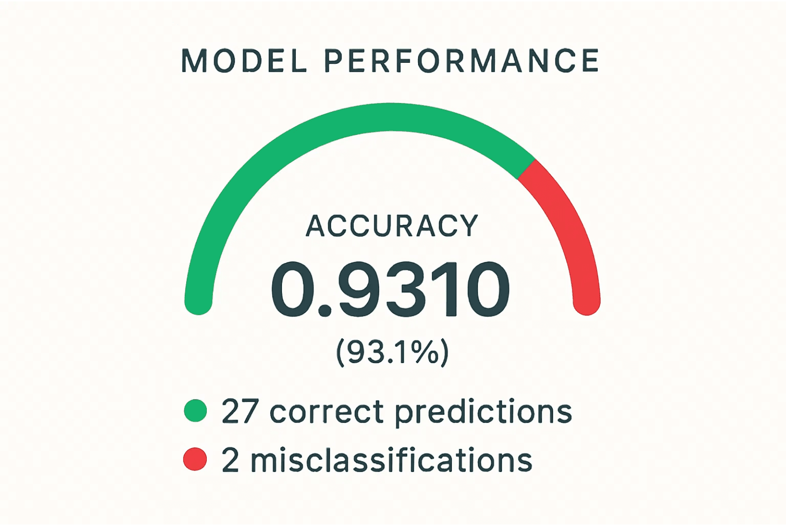
Evaluating Performance with
Multiclass Classification Evaluator
Evaluation Metric
For multi-class classification problems like Iris species identification, Accuracy is a standard and intuitive metric that measures the proportion of correct predictions.
PySpark Evaluator
The MulticlassClassificationEvaluator compares predicted labels against true labels:
Accuracy Calculation:
Correct Predictions / Total Predictions = 27 / 29 = 0.9310
Performance Summary
▪
Accuracy: 93.1%
– Excellent performance
▪
27 correct predictions out of 29 test samples
▪
Only 2 misclassifications
▪
Strong generalization to unseen data
Key Finding: The high accuracy demonstrates that Logistic Regression is highly effective at classifying Iris species based on the four measured features. The model generalizes well beyond the training data.

Slide 9

Summary of Findings and Future Work
Experiment Summary
▪
Successfully implemented a
complete PySpark ML pipeline
for Iris classification
▪
Achieved
93.1% accuracy
on the test set using Logistic Regression
▪
Demonstrated the power and structure of
PySpark ML frameworks
▪
Validated that
simple linear models
can be highly effective for well-separated data
Key Takeaway
PySpark ML provides a scalable, structured, and reproducible framework for machine learning workflows that seamlessly transitions from development to
production environments.
Future Work and Improvements
Hyperparameter Tuning
Use cross-validation and grid search to optimize model parameters and improve performance further.
Algorithm Comparison
Explore other classifiers (Decision Trees, Random Forests, SVM) to compare performance and identify the best approach.
Model Deployment
Deploy the trained model for real-time inference in production environments using Spark serving or REST APIs.
Scalability Testing
Test the pipeline on larger datasets to demonstrate Spark's distributed computing advantages.

Slide 10

Thank You

